Slide 1
Machine learning in a nutshell
Tens of thousands of machine learning algorithms
Hundreds new every year
Every machine learning algorithm has three components:
Representation
Model
Evaluation
Visualization

Slide 2
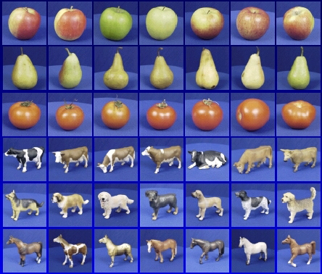

Machine learning steps
Training
Training Images
Image Features
Training
Learned model
Testing
Image Features
Learned model
Prediction

Slide 3
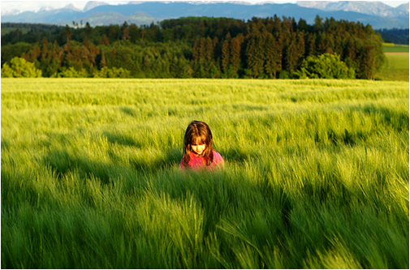
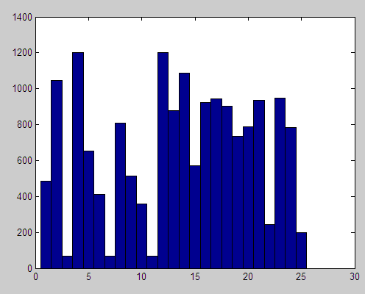
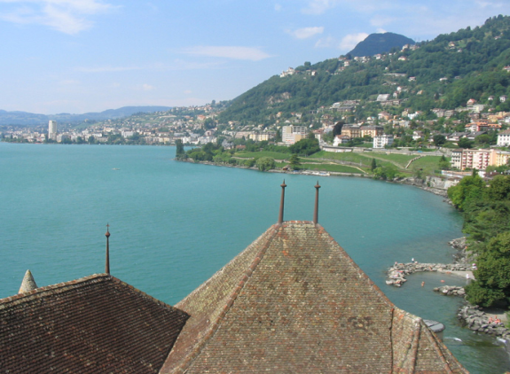
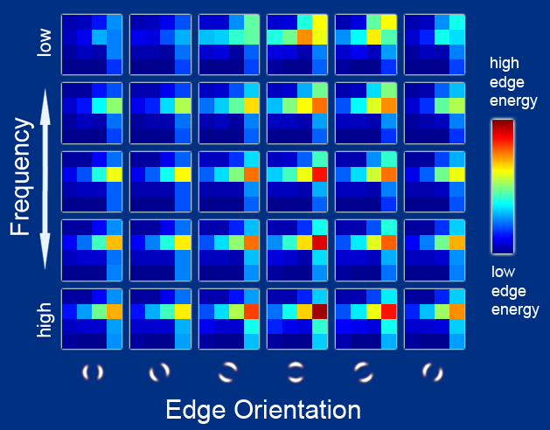
Representation
Raw pixels
Histograms
GIST descriptors
…

Slide 4
Three Steps for Deep Learning Training
Step 1: define a set of function
Step 2: goodness of function
Step 3: pick the best function
Neural
Network
Notes:
http://www.twword.com/wiki/%E8%85%A6%E6%88%B6%E7%A9%B4
http://ukenglish.pixnet.net/blog/post/105691160-%E3%80%90%E5%8F%B0%E5%8D%97%E5%B8%82%E5%AD%B8%E8%8B%B1%E8%AA%9E%EF%BC%8C%E5%84%AA%E9%85%B7%E8%8B%B1%E8%AA%9E%E6%96%87%E7%90%86%E5%85%AC%E5%91%8A%E3%80%91%E6%9C%AC%E4%B8%AD%E5%BF%83
http://onepiece1234567890.blogspot.tw/2013/12/blog-post_8.html

Slide 5
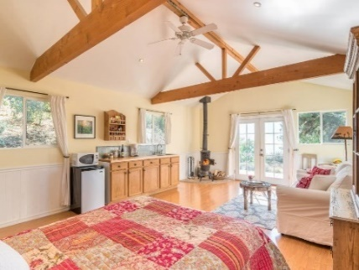
Supervised Learning
Traditional pattern recognition models work with hand crafted features and relatively simple trainable classifiers.
Limitations
Very tedious and costly to develop hand crafted features.
The hand-crafted features are usually highly dependents on one application.
Trainable Classifier
(e.g. SVM, Random Forrest)
Output
(e.g. Outdoor Yes or No)
Extract Hand Crafted Features

Slide 6
Fully Connect Feedforward Network
neuron
Input
Layer 1
Layer 2
Layer L
Output
……
y₁
……
y₂
……
……
……
……
……
……
y_{M}
Input Layer
Output Layer
Hidden Layers
Notes:
You can connect the neurons by other ways you like ☺
How many layer is deep?
CNN just another way to connect the neuros.
You can always connect the neurons in your own way.
“+” is ignored
Each dimension corresponds to a digit (10 dimension is needed)

Slide 7
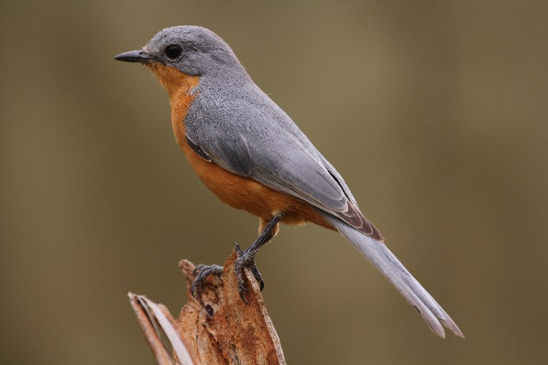
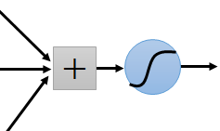
Why CNN for Image
Some patterns are much smaller than the whole image
A neuron does not have to see the whole image to discover the pattern.
Connecting to small region with less parameters
“beak” detector

Slide 8
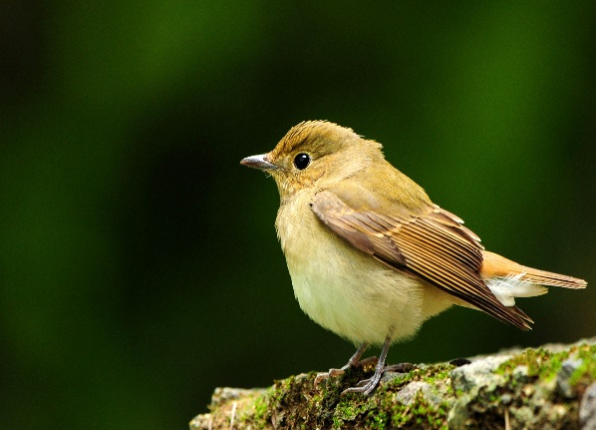
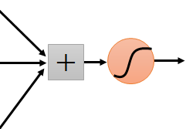
Why CNN for Image
The same patterns appear in different regions.
“upper-left beak” detector
Do almost the same thing
They can use the same set of parameters.
“middle beak” detector

Slide 9
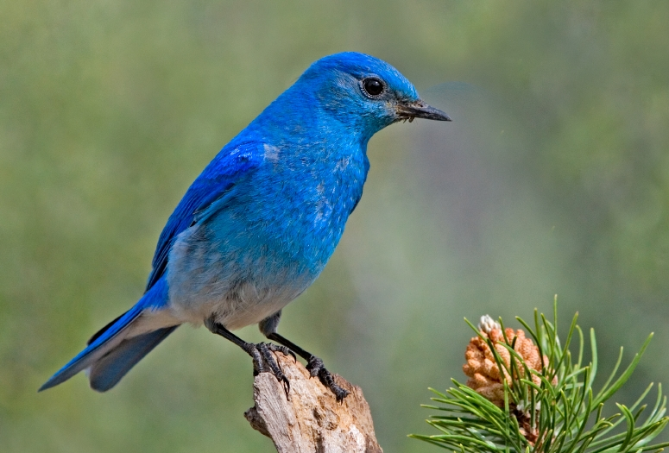

Why CNN for Image
Subsampling the pixels will not change the object
bird
bird
subsampling
We can subsample the pixels to make image smaller
Less parameters for the network to process the image

Slide 10
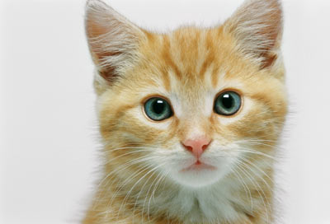
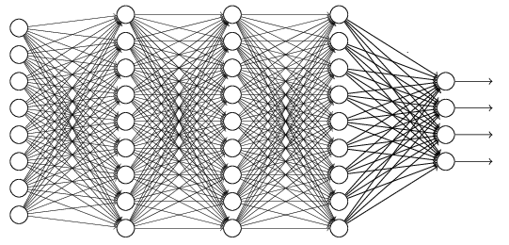
The whole CNN
cat dog ……
Convolution
Max Pooling
Can repeat many times
Fully Connected Feedforward network
Convolution
Max Pooling
Flatten

Slide 11
The whole CNN
Property 1
Some patterns are much smaller than the whole image
Convolution
Property 2
Max Pooling
The same patterns appear in different regions.
Can repeat many times
Property 3
Convolution
Subsampling the pixels will not change the object
Max Pooling
Flatten

Slide 12
The whole CNN
cat dog ……
Convolution
Max Pooling
Can repeat many times
Fully Connected Feedforward network
Convolution
Max Pooling
Flatten

Slide 13


CNN in Keras
Only modified the network structure and input format (vector -> 3-D tensor)
input
1 x 28 x 28
Convolution
How many parameters for each filter?
9
25 x 26 x 26
Max Pooling
25 x 13 x 13
Convolution
How many parameters for each filter?
225
50 x 11 x 11
Max Pooling
50 x 5 x 5

Slide 14
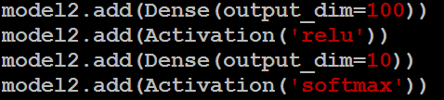
CNN in Keras
Only modified the network structure and input format (vector -> 3-D tensor)
input
1 x 28 x 28
output
Convolution
25 x 26 x 26
Fully Connected Feedforward network
Max Pooling
25 x 13 x 13
Convolution
50 x 11 x 11
Max Pooling
1250
50 x 5 x 5
Flatten

Slide 15

Auto-encoder
Usually <784
Compact representation of the input object
NN
Encoder
code
28 X 28 = 784
Learn together
NN
Decoder
Can reconstruct the original object
code

Slide 16







Recap: PCA
Minimize
$${\left(x−\hat{x} \right)}^{2}$$
As close as possible
encode
decode
$$x$$
$$c$$
$$\hat{x}$$
$$W$$
$$W^{T}$$
hidden layer
(linear)
Input layer
output layer
Bottleneck layer
Output of the hidden layer is the code
Notes:
A neutral net whose output tries to reconstruct the input
Target of output ($\hat{y}$) = input ($x$)

Slide 17






Deep Auto-encoder
Symmetric is not necessary.
Of course, the auto-encoder can be deep
As close as possible
…
…
Layer
Layer
Output Layer
Input Layer
Layer
bottle
Layer
Layer
Layer
$$W_{2}^{T}$$
$$W_{1}$$
$$W_{2}$$
$$W_{1}^{T}$$
Initialize by RBM layer-by-layer
$$x$$
Code
$$\hat{x}$$
Reference: Hinton, Geoffrey E., and Ruslan R. Salakhutdinov. "Reducing the dimensionality of data with neural networks." Science 313.5786 (2006): 504-507
Notes:
codes

Slide 18




Deep Auto-encoder
Original Image
784
30
784
PCA
Deep
Auto-encoder
784
1000
500
250
30
250
500
784
1000
Notes:
Hand-written digits
Deep auto-encoder has better reconstruction capability

